Slide 1
Introduction to R

Slide 2

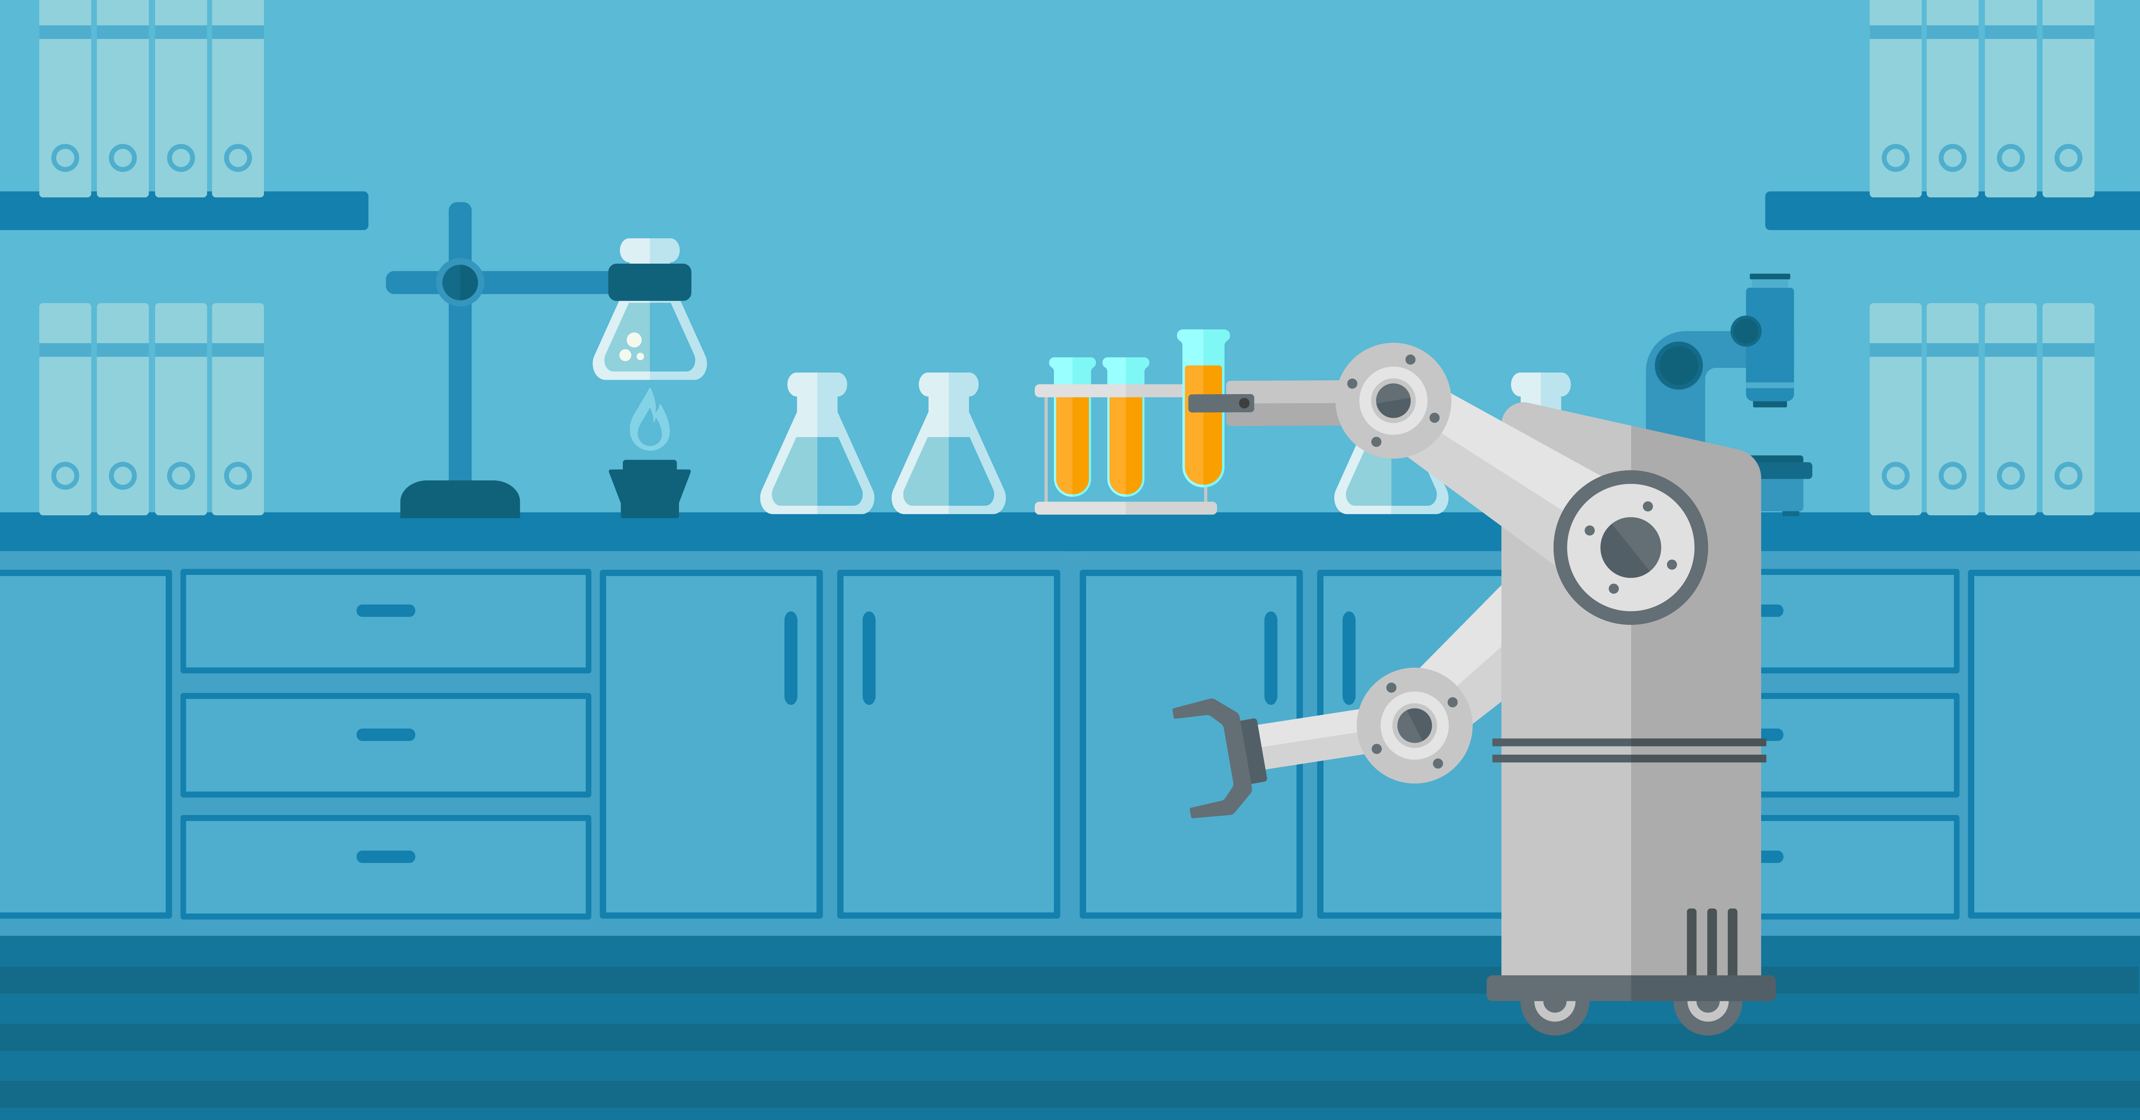
Welcome Welcome
Biology today…
Biology tomorrow…

Slide 3


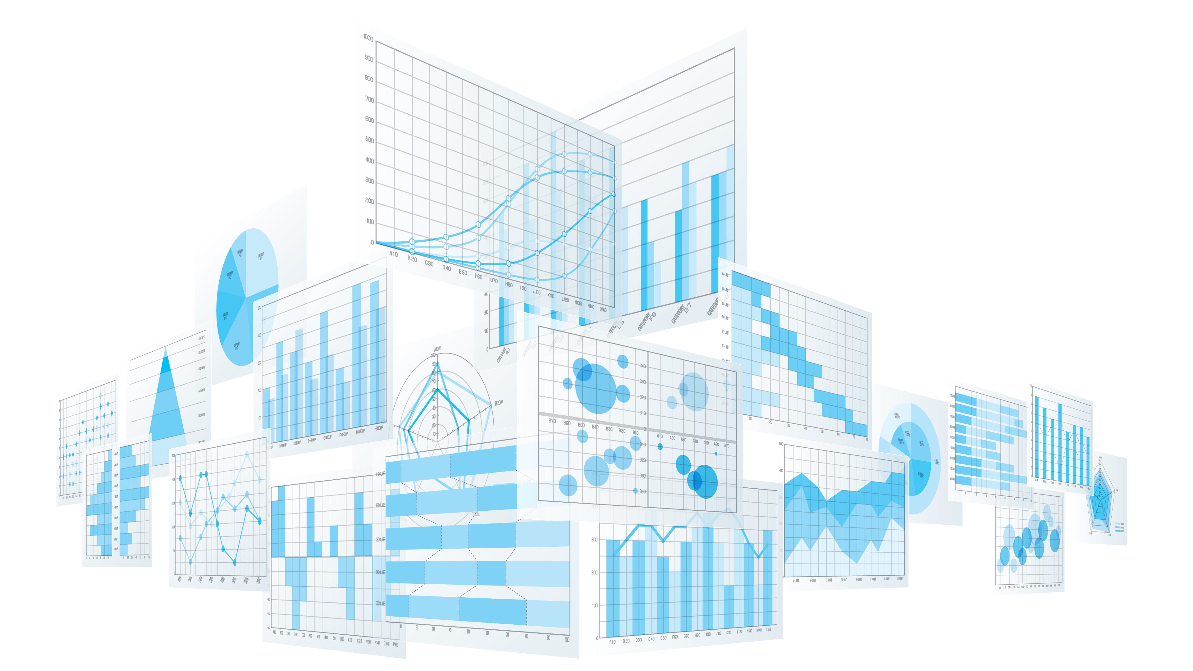
What is covered in this course?
Computer Science
Generics of writing code
Algorithms
R syntax
Graphics
Graphics
Charts
Math and Statistics
Statistical
programming

Slide 4
UAEB is still a gradeable module!
Component | Course ILOs tested | SBS Graduate Attributes tested | Weighting | Team / Individual | Assessment Rubrics
Continuous Assessment
Tutorials
Assignment | 1, 2, 3 | 5. a, b, c 7. a, b, c | 20 | individual | See Appendix for rubric
Participation | 3 | 5. a, b, c | 10 | individual | See Appendix for rubric
Presentation 1 | 1, 2, 3 | 5. a, b, c 7. a, b, c | 10 | team | See Appendix for rubric
Presentation 2 | 1, 2, 3 | 5. a, b, c 7. a, b, c | 10 | team | See Appendix for rubric
Presentation 3 | 1, 2, 3 | 5. a, b, c 7. a, b, c | 10 | team | See Appendix for rubric
Presentation 4 | 1, 2, 3 | 5. a, b, c 7. a, b, c | 10 | team | See Appendix for rubric
Presentation 5 | 1, 2, 3 | 5. a, b, c 7. a, b, c | 10 | team | See Appendix for rubric
Multiple Choice Questions (Theory test) | 1, 2, 3 | 5. a, b, c 7. a | 20 | individual
 |  | Total | 100%

Slide 5
Course Assessment Methods
Component | Weighting | Team/ Individual
Continuous Assessment
Tutorials
Programming Assignment | 20% | Individual
Quiz | 20% | Individual
Participation | 10% | Individual
Daily Presentations/Reflections | (10% per day) 50% in total | Team
Total | 100%

Slide 6
Course Deliverables and Timeline
Components | Day 1 | Day 2 | Day 3 | Day 4 | Day 5
Presentation/Reflection (Team) | 10 | 10 | 10 | 10 | 10
Participation |  |  |  |  | 10
Quiz |  |  |  | 20
Programming Assignment |  |  |  |  | 20
Programming assignment submission 2 weeks after
Due for submission

Slide 7

Learning Objectives
By the end of this course, you should be able to:
Deploy basic programming elements such as operators, control structures and variables in designing and interpreting algorithms
Implement logical expressions in R
Design and implement appropriate programmatic solutions towards practical problem solving

Slide 8
Assessment Components
Quiz (Individual) You will complete quizzes to test your understanding on various aspects of theory (20%). Results and explanations will be released to you.
Programming Assignment (Individual) As a finalization of learning, a programming assignment is to be turned in as a report at the end of the course (20%).
Participation (Individual) Consistent and evident enthusiasm/passion for learning and teamwork will be rewarded (10%).
Presentations/Reflections (Team) At the end of each day, participants, working in small teams, are to share, reflect and demonstrate their learning as mini-presentations for the class. This process is meant for closing the learning loop and achieves the objective of peer instruction simultaneously. Each presentation/reflection is worth 10%, for a total of 50% of overall grade.

Slide 9
What will we be covering (Day 1)
Day | Topic | Course ILO | Readings/ Activities
1 | Why R? Introduction to the elements of programming and good syntax style Applied algorithms in biology Pseudocode and algorithms R syntax Introduction to RStudio | 1, 2, 3 | Opening and welcome Class exercises Programming practice Reflection (10%)
Notes:
Elements of good syntax style (how to write nice looking code)
General: http://adv-r.had.co.nz/Style.html
R-specific: https://google.github.io/styleguide/Rguide.xml

Slide 10
What will we be covering (Day 2)
Day | Topic | Course ILO | Readings/ Activities
2 | R data structures Special programmatic elements in R | 1, 2, 3 | Programming practice Reflection (10%)

Slide 11
What will we be covering (Day 3)
Day | Topic | Course ILO | Readings/ Activities
3 | Graphs | 1, 2, 3 | Programming practice Reflection (10%)

Slide 12
What will we be covering (Day 4)
Day | Topic | Course ILO | Readings/ Activities
4 | Statistical programming | 1, 2, 3 | Programming practice Quiz (20%) Reflection (10%)

Slide 13
What will we be covering (Day 5)
Day | Topic | Course ILO | Readings/ Activities
5 | Applied Bioinformatics | 1, 2, 3 | Programming practice Programming assignment (20%) Reflection (10%) Review and wrap up

Slide 14
Course Expectations
Practice.
Don’t be passive, learn with and from your team members.
Use your creativity and intuition.
Don’t be afraid to fail.
You are responsible for your own submissions. Non-submission for any component will result in a zero marking. There is no substitute for the programming assignment.
Teamwork: Learning and working together in teams, and as a class, is a requirement
Individual: If you are faster than the others. Spend time practicing programming, work on theory, and very importantly, be a peer mentor to your peers

Slide 15

Daily workflow
Come to class with your laptops
Lecture + hands-on activity (2 hours)
Practice (1 hour)
Application + preparation of mini-presentation (2 hour)
Presentation + Reflection (1-2 hour)

Slide 16
Quiz (20%)
20 multiple-choice questions corresponding to content from days 1 to 4

Slide 17
Programming Assignment (20%)
You will be required to demonstrate the ability to design and implement an algorithm in the R programming language, and produce a report based on this.
The objective is less on writing code that works, but more to evaluate creativity, good programming practices, demonstration of understanding of the concepts taught previously, and critical thinking.

Slide 18
Participation (10%)
You are strongly encouraged to participate in discussions during the workshop, including sharing your own learning, the problems/ issues you encountered, solutions, as well as Q and A during others’ presentations.

Slide 19
Presentations/Reflection (50%)
At the end of each day, a team presentation will be carried out for the purpose of sharing and communicating with the class the learning objectives of the day, and what has been achieved yourselves.
Each presentation is worth 10%.
What should you talk about?

Slide 20
What do I look for in your daily presentations?
Clear demonstration of sound thinking and creative use of domain knowledge
Demonstrate clear articulation and understanding of subject matter.
Clear signs that mutual synergy and learning has been enhanced due to peer-to-peer exchange
High quality insights. Able to clearly make relevant links to previous knowledge/exercises, and to the subject matter/discipline.
Each of you will get about 20-30 minutes. Use that time well.
No imposed format. Use your creativity (Free-Style)
Learn from each other and most importantly, enjoy the process!

Slide 21
So where does this course lead to?

Slide 22
Appropriate Application
Programming for its own sake is useless
It is like learning how to read a score, but never playing the piano
It needs to be applied appropriately
One way it can be applied is in data science
Programming is to computer/data science, what petri dishes are to biology/chemistry

Slide 23
The components of data science
Business, Biology, Sociology
Domain
Implementing algorithms, repetitive analysis, storing data
Deriving appropriate metrics for summarizing, normalizing data
Computing
Maths/Stats
Programming
Theoretical statistics
Algorithms
Computer graphics
Applied statistics
Research design
Machine learning and AI
Databases
Network modeling
Notes:
Any levels of analytics would involve 3 components – the domain knowledge, math and statistics, and computing.

Slide 24
The steps of a Data Science investigation

Slide 25
Data Science for scientific investigation
It follows the same basic procedure as a ‘normal’ wetlab scientific experiment
Model monitoring
Choose a question to investigate
Determine if results support or refute your hypothesis
Project definition
Deployment
Identify a hypothesis related to the question
Determine results and assess their validity
Data collection
Make testable predictions in the hypothesis
Collect data in experiment
Data analysis
Statistics
Design an experiment to answer hypothesis question
Modelling

Slide 26
Data Science for scientific investigation
Is there evidence of a genetic cause for depression?
Can the genes predict phenotype on another data set?
Genetics and Psychiatry
Model monitoring
Choose a question to investigate
Determine if results support or refute your hypothesis
Project definition
Immune genes are observed to go awry
Deployment
Identify a hypothesis related to the question
Genes may cause depression?
Are the genes consistently altered?
Determine results and assess their validity
Do they uniformly affect a pathway?
Immune genes are a potential cause of depression
Gene expression measurements
Data collection
1. Select N normal and N patients.
2. Measure all immune genes
3. See if genes are differential
Make testable predictions in the hypothesis
Collect data in experiment
Clean and normalize data
Data analysis
Do t-test
Statistics
Design an experiment to answer hypothesis question
Cluster the samples
Modelling

Slide 27

Diagnostic Analytics
Gene X is correlated with disease
Condensed data
Noise
Gene X Level
Noise removal
Disease severity
Target Gene X
Gene X is not a cause
Gene X Level
Disease severity
Builds on top of descriptive analytics
May involve denoising, renormalization and bias correction
Infers relationships in data, aim is to identify key causes

Slide 28
Predictive Analytics
Clustering
Data Modelling and Prediction
+
Machine learner
Normalized/Cleaned data
Trained
Machine
learner
Predicted to be Class A
+
Builds on top of descriptive and diagnostic analytics
May involve the use of clustering and machine learning techniques (data modelling)
Goal is to predict the identify of an unknown entity, or determine when a phenomenon will happen (e.g. cancer relapse)

Slide 29
To do these, you need to know how to programme
And this is a good reason to start by learning R.
However, a sound understanding of computer science concepts, maths and domain knowledge (such as biology) is still highly essential.
To build up on these, you may consider taking BS3033 (Data Science for Biologists)

Slide 30
Begin downloading and installation of the following:
R (https://cran.r-project.org/)
Rstudio (https://www.rstudio.com/)

Slide 31

Hope you enjoy the course

